Slide 1

Entertainment Identifier Registry (EIDR)
Efficiency, Automation, and Monetization for
Global Video Supply Chains
March 2010
DOI Outreach
December 2013
Raymond Drewry
rdrewry@eidr.org

Slide 2
Presentation contents
The digital world is here to stay
Why are Identifiers essential in a global, digital economy?
The EIDR Identifier: a worldwide consortium
Technology
Example uses and applications
Standards and Developer Support

Slide 3
Presentation contents
The digital world is here to stay
Why are Identifiers essential in a digital world?
The EIDR Identifier: a worldwide consortium
Technology
Example uses and applications
Standards and Developer Support

Slide 4
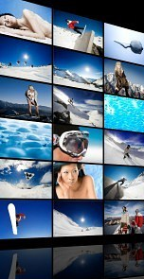









The analog to digital transition is here to stay
analog broadcast
digital
Broadcast multi-channel
On
demand
Multi
screen
black & white
color
Analog spectrum
MPEG transport
IP transport
DVR
1990s
2000
2010+
Notes:
This is just television; film follows the same trends

Slide 5


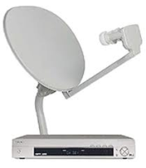

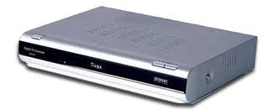
More and more digital distribution channels are opening up
Distribution competition means more choices for the consumers, more leverage for the content owner, and more complexity in the distribution infrastructure
broadcasters
Game consoles
Connected
Blu-ray
Direct to consumer
Connected TV
independents
TelcoTV
Over The Top
Content aggregators
studios
Satellite
Cable / Satellite
Cable
Disc

Slide 6
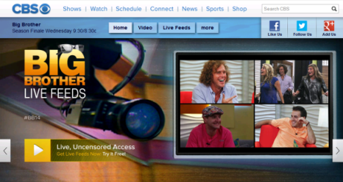


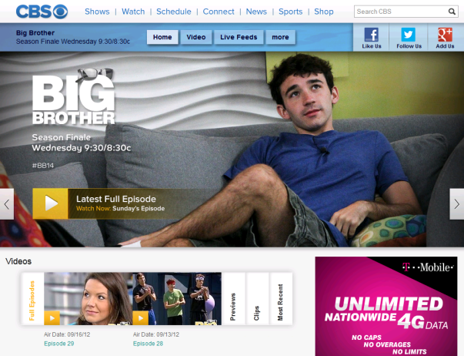


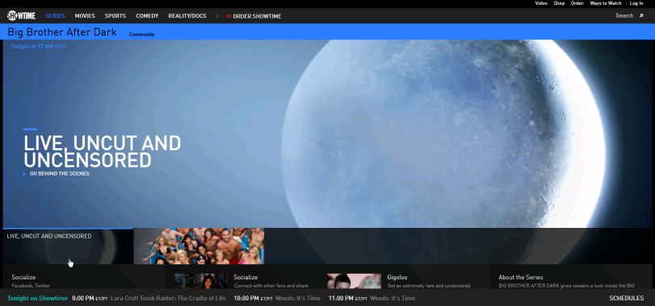
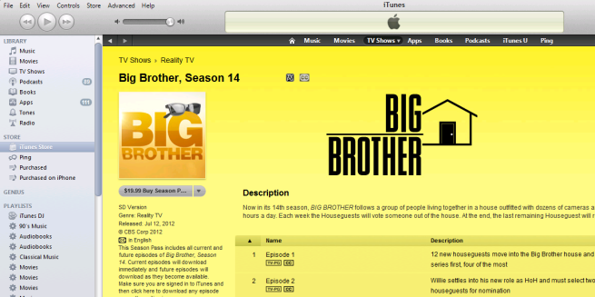
There are more and more ways to package content
Extended version…
Video On Demand
Original disc format…
3D version…
Catch-up TV…
Live stream to PC…
File download…

Slide 7







Millions of film and TV products created each year
Digital encodings of movies, TV shows, clips
Packages
Retailer SKUs
Cumulative unique assets for distribution
Network , Pay TV Distributions
Formats, Regions, Languages, Subtitles
Versions
Edits
Digital technology, new formats and player devices have caused the number of unique products for a movie or TV production to explode

Slide 8
Presentation contents
The digital world is here to stay
Why are Identifiers essential in a digital world?
The EIDR Identifier: a worldwide consortium
Technology
Example uses and applications
Standards and Developer Support

Slide 9

In a digital world, there is an explosion of possible sources of confusion when handling video assets
What do you have?
  ‘Lost in Thailand’
What if someone else calls it something different?
  Is that the same as ‘Lost on Journey 2’?
How do you know if two things are the same?
What does ‘the same’ mean?
  You asked for HD and all I have for your device is SD. Are those the same enough?

Slide 10
And by the way.....
The spreadsheet/email/manifest/post-it note/whatever says ‘HP/Lost in Thailand:EN ES SUB:JP DUB: H264-AAC’
  So text strings are problematic
  And so are titles....
  And so are languages....
  And so are formats....

Slide 11


In a digital world, there is thus an explosion of video files
Versions Theatrical
Director’s cut
Short form
Distribution Broadcast
Cable
VOD
Satellite
Internet
Audio Language Chinese Mandarin
Chinese Cantonese
Subtitling English
Encoding format mpeg2, 4, h264
WM, QT, Flash
etc

Slide 12
In a digital world, there is an explosion of hand-offs between distribution systems and actors
programmer
broadcaster
equipment
vendor
advertiser
distributor/
service
provider/
content
aggregator
audience
content
creator
&
rights
owner
fees
reporting
usage
tracking
& business
intelligence

Slide 13
So what is an identifier?
It is a convenient, usual name for something
It’s especially useful if it’s unambiguous
It’s especially useful if everyone knows it
It’s more convenient if everyone knows how to use it
Standard
Unique
Universal
Interoperable

Slide 14
Presentation contents
The digital world is here to stay
Why are Identifiers essential in a digital world?
The EIDR Identifier: a worldwide consortium
Technology
Example uses and applications
Standards and Developer Support

Slide 15

What is EIDR? – The Big Picture
Global B2B Registry for unique identification of entertainment content and video services
  Identifier solution to span the global video industry supply chain
  Implementation of ISO 26324 Digital Object Identifier (DOI) standard
  Describes AV assets and
    How they relate to each other
    How they relate to other identifier systems
API-Based Enterprise Solution
  Real time registry access, with resulting efficiencies in the supply chain
  Shared identifiers reduce friction, increase efficiency
  Allows new kinds of businesses and applications
Standard
Unique
Universal
Interoperable

Slide 16
What is EIDR? – some details
EIDR Purpose
  Make digital distribution competitive
  Help reduce costs
  Improve collaboration and automation across multiple application domains & platforms
  Enable new businesses and create new efficiencies
What EIDR is
  Global registry for unique identification of movie and TV content
  Designed for automated machine-to-machine communication
  Flexible data hierarchy down to the product & SKU level, incl. edits, clips, composites, encodings, and relationships
What EIDR is Not
  Profit-making
  Rich commercial metadata
  Ownership or rights information
  US-only
EIDR Technology Summary
  Interoperable, standards-based infrastructure
  Built on ISO 26324 Digital Object Identifier (DOI) standard
  Application integration through public APIs and schemas, freely available SDK for members
  Efficient infrastructure for new and existing applications

Slide 17
Scope and basic approach
Industry enabling philosophy
A clear positioning
A proven resource to the industry
  Cost-effective for large-scale use
  Cost-recovery participation fees
Not competitive with existing commercial services
  Minimal descriptive metadata
  Strong focus on metadata for uniqueness only
Interoperable with existing standards and IDs
Clear boundaries for what it does and doesn’t do
Designed for ubiquitous adoption w/ no restrictions on use or mirroring
IP-neutral with no implication of ownership, no rights data
Opaque IDs with all metadata kept up to date in a database
Permanent and persistent B2B service
Continuous registration of new and back-catalog/archive content
  Metadata providers and production companies
In operation since December 2010
  Currently 45 member companies
  ~535,000 IDs registered
  High level of member participation
17

Slide 18
What you can do with it
Register IDs
Modify
metadata
Use IDs
  Any member can request an ID
  Can use UI, desktop applications, custom integration, or help desk requests
  The first one to need an ID for an asset registers it, after which anyone can use it
  Quality is key
  Correct mistakes
  Request permission to modify records of interest that someone else registered first
  Add Alternate IDs
  Resolve an ID to get its metadata
  Retrieve an ID’s alternate identifiers
  Follow relationships and hierarchies
  Query for IDs based on metadata fields
  Most importantly: SHARE THEM WITH OTHERS

Slide 19
Governance and operations
Run by the members, for the members
All-you-can-eat use model and access
Lean and agile technology infrastructure
  2 non-profit industry associations & 7 commercial companies on the board
  Membership dues based on company size (set annually, currently $5K - $ 35K)
  Some non-profits join for free and contribute in kind in various ways
  Very small participants interact through a service bureau model
  Registrations are free for members
  Lookups are free to anyone through the EIDR registry UI or the DOI Proxy (multiple formats)
  Members can integrate with the registry API using a variety of technologies (Java, .NET, XML and REST)
  Members can mirror the entire Registry.
  Operations and most engineering are contracted out
  Built on tested and trusted DOI and Handle System architecture
  Small permanent staff
  Some staff loaned by member companies
  New features are defined by technical working group

Slide 20


















































The EIDR Organization – Current Membership
Promoters
Contributors & Supporters
EXACTUALS
Notes:
New members: Netflix, Inflight Productions

Slide 21
























































EIDR – worldwide members, by industry sector
Archives
Producers &
programmers
Aggregators
Distributors
Reporting, tracking,
business intelligence
Infrastructure and media services
Metadata
Labs
Industry & standards organizations
CableLabs Japan

Slide 22
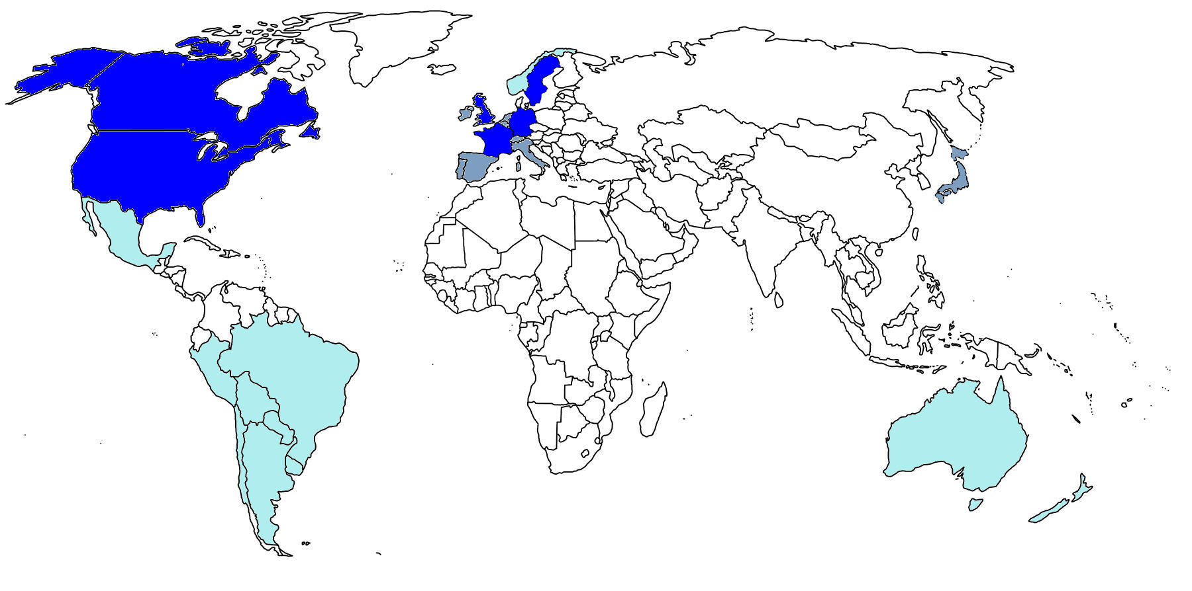
A global reach
Active members
Active deployments
Membership discussions
Planning deployments
Anticipating deployments through studios digital distribution

Slide 23
Global coverage already starting
Mostly from US
  No surprise there
  450,000 or so
But, the global nature of digital video distribution means
  More than 10,000 each from GB, CA, DE, FR
  More than 1000 each from IT, JP, AU, ES, AT, HK, SE, CH, NZ, CN
  More than 450 each from DK, MX, IN, IE, NL, BE, KR, BR, FI, PL, RU
Digital content is international
  So is its distribution
  People who need IDs just ask for them – the ID has no implications of ownership or control

Slide 24
Current Registry contents
Category | 2010 | 2011 | 2012 | Nov-13
Title-level records:
Movies | 43,573 | 45,774 | 51,501 | 75,358
Shorts | 1,121 | 1,224 | 1,406 | 2,527
One-Time-Only TV | 17,952 | 22,199 | 26,112 | 29,267
TV Episodes | 105,891 | 130,284 | 158,371 | 276,678
TV Series | 7,541 | 8,719 | 9,613 | 12,886
TV Seasons | 7,837 | 9,486 | 12,197 | 17,523
Edits & Manifestations | 0 | 3,460 | 20,701 | 122,958
Total records | 183,915 | 221,146 | 279,900 | 537,197

Slide 25
Current EIDR Registry contents

Slide 26
Alternate IDs – records can have more than one
Category | Today
Any Alternate ID | 235,493
Sony | 129,676
Warner Bros | 47,791
ISAN | 43,303
IMDb | 37,790
IVA | 30,128
Flixster | 29,819
Baseline | 20,931
Category | Today
Netflix | 17,650
TheCinemaSource | 12,042
NBC Universal | 7,775
Amazon | 7,062
Records with a proprietary ID: 212,128
Approx 45% of records have at least one external identifier
26
Notes:
Importance of using EIDR to link across systems

Slide 27
Presentation contents
The digital world is here to stay
Why are Identifiers essential in a digital world?
The EIDR Identifier: a worldwide consortium
Technology
Example uses and applications
Standards and Developer Support

Slide 28








An ideal ID registry for the supply chain
Coverage: Ability to generate unique identifiers for all types of digital AV content
Flexibility: Support wide variety of objects, hierarchies & relationships between objects
Cost-effectiveness: Must make economic sense for large volumes
Interoperability: Must be able to interoperate with other registries & IDs
Scalability: Ability to handle very large volumes of registrations and lookups at production level SLAs
Extensibility: Can be readily extended to accommodate new types of assets in future
Value-added Services: Must support the ability of vendors to offer value-added services & applications
Accessibility: Open search and query access without restrictions. All applications have equal access. Network accessible.

Slide 29
Basic technical approach
Centralized registry to guarantee uniqueness
  Opaque IDs
Strong focus on metadata required for unique identification
  Metadata fields fine enough to distinguish items from abstract works down to clips, composites, & encodings
  Robust hierarchies and relationships flexible enough to cover known and unknown variations
Extensible to meet new industry requirements
  Based on DOI infrastructure
Scalable, automated operations for efficient supply chain
  Based on DOI infrastructure
SDK & other tools available
  UI and DOI proxy for resolutions (you can do a lot with that)
  API for more complicated things
Works with standards & specs from
  DOI, EBU, CEN/EFG, Ad-ID, ISRC, ISAN, DDEX, Ultraviolet, EMA, CableLabs, MovieLabs,…

Slide 30
EIDR – enabling scalable content services
Asset
in the abstract
(title, year, movie/TV, series,
episode, etc.)
Unique embodiments
(edits, translations, encodings, clips, composites, physical or digital medium, etc.)
EIDR
Value-added
metadata
and services
Offer
terms
Ownership
and license
rights
Contributor
metadata
(cast, crew, etc.)
Digital
revenue
reporting
Metrics
& Analytics
EIDR provides a common link for
an unlimited number of value-added services.
30

Slide 31
Example EIDR movie hierarchy
Titles
(Abstractions)
Movie
IsPromotionFor
Movie Trailer
Editions
(Performances)
IsEditOf
IsEditOf
Theatrical
(Original Domestic)
Director’s Cut
IsEditOf
IsEditOf
Theatrical
(Regional Release)
Home Entertainment Edition
Manifestations
(Digital)
IsManifestationOf
Similar Hierarchy
Here
Mezzanine
(EN, FR, SP)
Blu-Ray Disc Image
Mezzanine
(EN, FR, SP)
IsManifestationOf
Retailer SD
(EN)
Retailer HD
(EN)
VOD
(EN, FR, SP)

Slide 32
Example EIDR episodic hierarchy
Series
(Abstractions)
Series
Seasons (Abstractions)
IsSeasonOf
IsSeasonOf
Season 1
Season 2
Episodes
(Abstractions)
IsEpisopdeOf
IsPromotionFor
Episode 1
Episode2
…
Episode N
IsPromotionFor
Similar Hierarchy
Here
Season 2 Trailer
Edits
(Performances)
IsEditOf
Broadcast Edit
Broadcast Edit
Broadcast Edit
IsClipOf
Promotional Clip
Manifestations
(Digital)
IsManifestationOf
Retail EST
(EN, FR)
Retail EST
(EN, FR)
Retail EST
(EN, FR)
Social Upload
UGC Upload

Slide 33

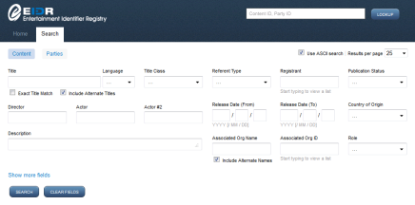
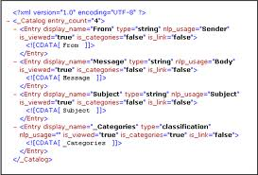
How to access the registry
The EIDR platform provides multiple methods for creating IDs
And provides flexible solutions and tools to integrate and manage the ID creation process
Same mechanisms exist for query, resolution, modificaiton, etc.
Member platform and systems
XML or formatted file
API integration software
EIDR web console
EIDR SDKs
EIDR system API
EIDR

Slide 34
Presentation contents
The digital world is here to stay
Why are Identifiers essential in a digital world?
The EIDR Identifier: a worldwide consortium
Technology
Example uses and applications
Standards and Developer Support

Slide 35
Standards drive automation which cuts costs
Producers
Programming
Broadcasting
MVPDs
Infrastructure
Usage
reporting
Archiving
Cut ingestion costs one ID for avails, marketing metadata, file delivery; one system for all partners
Standardized content discovery surface EIDR IDs in APIs for easy, automated discovery by all apps
Matching match once, then never again
Metadata acquisition buy the best data from multiple sources with one standard ID
Cross-platform delivery all vendors on every platform talk the same ID language
Data roll-up and reporting series/season/episode automatic roll- ups without manual reconciliation

Slide 36
Where you will start to see EIDR IDs
Theatrical
EST/Rental
MSO VOD & TV Everywhere
Broadcast & Ad-supported
  Ratings -MPAA, BBFC
  Box office sales –Rentrak
  Archives – BFI
  Digital Cinema Packages?
  UltraViolet
  All online retail
  MS, Google Play, Vudu
  ML, DEG, EMA specs – avails, metadata, reporting
  VOD deliveries to operators
  Metadata feeds
  Discovery services
  Reviews
  Home video sales – Rentrak, MediaMorph
  VOD work flows
  Comcast, TWC, Shaw, Cox, Charter, Brighthouse
  Guide data
  CableLabs specs
  Search & recommendation
  Parental ratings
  VOD sales - Rentrak
  Nielsen data
  Cross-platform ad/program tracking
  Guide data
  Cue sheets
  Re-broadcast rights collections
  BXF, ATSC, EBU, EN metadata mappings
  Int’l TV distribution

Slide 37
Use Cases
Title Management at content producers
Retail distribution
On-demand services
Broadcast
Mapping IDs and metadata across parters and suppliers
Measurement, Reporting, and Tracking
Archives
…
Notes:
No slides for Title management; will go through ... if still time and interest

Slide 38


Current Studio Deployment - UltraViolet
EIDR use:
Studios need to map a physical disc (Blu-ray) to a digital locker account, and associated playback rights.
A retailer or service provider who operates a digital locker wants to distribute, as part of their service, the movies of a specific subscriber, and needs to check the digital locker.
Examples:
Problem solved:
Uniquely identify a video asset along the digital distribution chain.
Associate particular edit and related CFF files to specific purchased rights.
Architecture:
ROI:
Incremental revenue
Monetization through matching of physical asset (disc) and digital distribution
Disc purchase
UltraViolet
VOD
studios
distributors
EIDR SDK
ID
Creates, matches, and validates assets uniquely
EIDR system API
EIDR
Notes:
Retail distribution

Slide 39

Online retail - UltraViolet ecosystem
EIDR
Web Portal
Metadata & Rights Tokens
Registrations and EIDR #
Rights
Metadata and EIDR #s
UltraViolet Coordinator
Studio
Content Provider
Metadata & Rights Tokens
Rights
Retailer
Streaming
(LASP)
Vudu
LASP
Other
LASP
Media and EIDR #s
Metadata,
Video and EIDR #s
Content Delivery Network
Request
Download
(DSP/Retailer)
Retailer
DSP
Retailer
DSP
Media and EIDR #s
Fulfillment
LASP – Locker Access Streaming Provider
DSP – Download Service Provider

Slide 40


Use Case – Electronic sell-though
EIDR engaged Cognizant to develop an independent case study to capture the benefits of a pilot implementation of the EIDR number between Warner Bros. and Microsoft.
EIDR number was integrated across the content ordering and delivery workflows, and sales and royalty reporting for theatrical titles sold on Xbox.
Benefits were identified and measured with total estimated direct savings of 650 employee-hours/year for integration with a single partner, and added savings realized with every partner added to this work flow.

Slide 41
Online retail - Warner Bros & Xbox Live
Integration Points
WB’s MSB metadata management system to the EIDR directory. Requests and applies new EIDR #’s to WB titles.
WB’s MSB system to the Avails system (RRTS) to provide the EIDR # on avails titles
  Facilitating Microsoft reporting back to WB with EIDR detail
1
1
2
2
Benefits Identified
Reduction in QC efforts
Reduction in customer queries
Improved reporting / invoicing capabilities

Slide 42
Video On Demand (Service Provider’s view)
Program Providers
PAID+EIDR
Rovi
Rovi ID+EIDR
Other Metadata Providers
Proprietary ID+EIDR
Comcast
Comcast ID+EIDR
Reporting Providers
EIDR
42
Notes:
On-demand services

Slide 43
VOD Distribution & Tracking – another view
EIDR
Programmer registers content
VOD Aggregator puts EIDR in ADI feed
MSO adds EIDR to internal tracking
VOD results correlated with EIDRs
Provides ability to report better VOD results, i.e., series level vs episodic level, rolled-up reports for content regardless of format (SD, HD, 3D)
Eliminates need to send content metadata multiple times when re-pitching assets
  Enables retrieval of robust metadata from third-parties for QA/enhancement
Enables MSO to roll up VOD episodes into a series package
Enables MSO to integrate metadata from multiple sources in a robust database
Enables MSO to utilize metadata across platforms (Linear, VOD, Online)

Slide 44
Use Case - Video Services with Alternate Content
Programmer View
 | 1 | 2 | 3 | 4 | 5 | 6
Primary Feed 10.5239/0000-0001 | Program | Program | Hockey: New York Rangers vs. Philadelphia Flyers | Hockey: San Jose Sharks vs. Los Angeles Kings | Program | Program
Alternate Feed 10.5239/0000-0002 | Off Air |  | Hockey: Buffalo Sabres vs. Montreal Canadiens | Hockey: Detroit Red Wings vs. Colorado Avalanche | Off Air
Subscriber View – Option B
 | 1 | 2 | 3 | 4 | 5 | 6
Los Angeles | Primary Feed 10.5239/0000-0001
Buffalo | Primary Feed 10.5239/0000-0001 |  | Alternate Feed 10.5239/0000-0002 | Primary Feed 10.5239/0000-0001
Denver | Primary Feed 10.5239/0000-0001 |  | Alternate Feed 10.5239/0000-0002 |  | Primary Feed 10.5239/0000-0001
No unique regional identifier. Client effectively switches between video services automatically. Much easier to maintain in EIDR, but would not provide a way to represent client video services in an EPG.
Notes:
Broadcast services

Slide 45
Targeted Ads in SCTE 130 Architecture
Advertising Opportunity
EIDR Content ID
EIDR Video Service ID
Subscriber Information
Ad Decision Service
Ad-ID
Or
EIDR
Advertising Placement
45

Slide 46

Retail and on-demand : metadata enrichment
Critic Reviews
Vendor Metadata
Comments from Friends
EIDR
Studio Metadata
Cast Bios & Filmography
Related products offers
Notes:
Mapping IDs and metadata

Slide 47


CableLabs Social Networking
Comcast
TWC
Check out this show.
Content + EIDR
Content
EIDR?
Facebook, Twitter, etc.
http://dx.doi.org/10.5240/4EFA-6EE4-9893-3604-E808-G
Comcast
Subscriber
TWC
Subscriber
47

Slide 48



1
INT ID
2
DOM ID
Theatrical Use Case: Simplification
via EIDR/Rentrak Partnership
FILM USERS
Dom Calendar
3
INT TH
HTTP
Dom & Int Release
Date/BO Reports
INT HE
MIDAS ID
Email
AS-IS
4
COMPETITIVE CALENDAR
FAME ID
INT HE
5
DOM HE
CC ID
7 different IDs and mapping
No linkage between Rentrak Domestic & Int’l
Time consuming manual matching, unmatched titles
COMP DB ID
CC ID
DOM HE
6
BORIS
BORIS ID
TV
7
CC ID
Manual
ANTI-PIRACY
IMPROVEMENTS
EIDR
INT
FILM USERS
Common ID for internal and external
Linked Rentrak Domestic & Int’l Th’l Data
- across windows down the line
Reduced title matching for Universal titles
- reduced matching for competitive titles if other studios provide EIDRs to Rentrak
Long Term
Eliminates mapping for new co-distribution deals
Brings EIDR to the beginning of Product Distribution Lifecycle – providing early linkage point for downstream distribution and performance data
Global Calendar
INT TH
HTTP
Global Comps
TM/EIDR
MAGIC
Email
Schedule Analysis
6 RENTRAK feeds - DOM
TM/EIDR
BO Projections
Global Release
Date/BO Reports
MEDIA SERVER
TM/EIDR
Title Mgmt
TM/EIDR
TM/EIDR
INT HE
TM/EIDR
TM/EIDR
INT HE
FILM
DW
TIBCO
DOM HE
DOM HE
TM/EIDR
TM/EIDR
TV
TV
TM/EIDR
ANTI-PIRACY
Notes:
Measurement, reporting, and tracking

Slide 49
Direct audience measurement
Panel ratings not sufficient for new TV platforms
Ad industry needs to measure viewership across an increasing number of platforms
  Smart phones, tablets, PCs, connected TVs, etc.
Direct measurement offers greater reach and accuracy
Requires standardized IDs for programs and ads
CIMM-TAXI industry group in North America endorses EIDR for program ID
  Estimates $2.5B benefit to the media industry
Industry needs a uniform ID for all programs to automate direct measurement of viewership.

Slide 50
















Rights recovery
Claims & cue sheets
Broadcast data
Scheduling data

Slide 51
Content ratings
Every country rates content differently
Films are often available in multiple versions
Have to be sure the rating is attached to the right version of the film
  Managing based on modified titles is error-prone and confusing
Pilot project underway at MPAA (US rating agency) to use EIDR
  Simplify the process
  Remove errors and ambuguity
BBFC (UK rating agency) is scoping a similar project

Slide 52
Content archives
Members include British Film Institute, British Universities Film & Video Council, Internet Video Archive
US studios are registering their archives now
Active discussions with British Library, INA (France), Library of Congress (US), Cinematek (Belgium)
Developing applications
  BUFVC – academic citation of AV works
  BFI – National TV archive project
  BFI – online availability of BFI titles
  British Library – news archive
  INA – French TV archive & fingerprinting applications
  IVA – internet distribution of film trailers
Notes:
Archives

Slide 53
European Projects
BBC
  Trial of EIDR registration underway
  BBC WW: proposed project for global content distribution
ITV
  Dual ISAN/EIDR registration (underway)
  Content flow-through to BFI (via Deluxe as encoding house)
Orange
  Catalog matching trial
  Viaccess/Orca subsidiary has joined EIDR
Canal +
  Trial of catalog matching
  Films to BFI (in planning)
Mediakraft
  Online video production and distribution
Notes:
...and the others

Slide 54
Other projects
Customer | Description
NBCU/MPAA, Rovi | Early Registration
RSG Media, Rogers | Rights Management
HBO | Title Matching and Registration
Comcast | VOD distribution, metadata aggregation, reporting
Time Warner Cable | VOD, National Channel Map, Recommendations
Shaw | Integration in Recommendations Environment
CableLabs | Targeted Advertising Proof of Concept Viewership Measurement Proof of Concept
Canoe Ventures | Dynamic ad insertion
Civolution, DigitalSmiths | Fingerprinting/Second Screen
Vudu, Google, Microsoft | Electronic Retailing, IP Distribution
Disney | Anti-piracy
British Film Institute | Content digitization; Public accessibility of collection information
Sony, NBCU, WB, Fox,… | Internal title management systems

Slide 55
Presentation contents
The digital world is here to stay
Why are Identifiers essential in a digital world?
The EIDR Identifier: a worldwide consortium
Technology
Example uses and applications
Standards and Developer Support

Slide 56
Standards: EIDR is becoming part of world’s standards
ISO
  EIDR is an implementation of ISO 26324 (DOI)
  Working with ISAN (ISO 15706) on interoperability projects and cross-registration
DVB
  Covered in “Companion Screens and Supplementary Streams Report:Current Experiences and Relevant Technologies” (TM-SM-CSS 0017)
SMPTE
  RP 2079 for use of EIDR in MXF media containers (KLV, URI, text) at Final Committee Draft.
  Can be used in AMWA AS-03 and AS-11
  RP 2021-5 carriage of EIDR in BXF at Final Committee Draft.
  Participating in SMPTE 24TB “Open ID Binding to Essence”
CableLabs
  Included in CableLabs VOD 3.0 spec
SCTE
  Carriage in SCTE-35 2013 segmentation descriptor
  Used in dynamic ad insertion via SCTE 130
  Proposed for MPEG transport on cable via SCTE 54.

Slide 57
Standards (continued)
EBU
  Mapping from EBUCore to EIDR registration data available in draft
  Joint participation in SMPTE Core metadata project
Linked Content Coalition
  EIDR is compliant with the LCC recommendations on interoperable and linked identifiers.
  LCC identifier principles endorsed by UK Digital Copyright Hub.
European Union
  EIDR is endorsed by the ‘Licenses for Europe’ project of the European Commission
EIDR supports a wide variety of ‘standard’ Alternate IDs
  Formal standards (ISAN, ISRC, CRID, ...)
  Common industry IDs (IVA, Baseline, Flixster,...)
  Commercial identifiers (Amazon, Netflix,...)
  De facto standards (BFI, IMDb,...)
  ...as well as proprietary internal IDs (studios, broadcasters,...)

Slide 58

Technical Governance
Open process
Very active technical working groups
  Work streams for best practices and new features
  Major changes sent to board for approval
Each release is a mix of enhancements and bug fixes
  Overall set of work items approved by TWG based on proposal from EIDR’s virtual technical staff
Engineering and management done by
  Full-time contractors
  Volunteers from member companies
  Systems operations staff
58

Slide 59
Documentation
http://eidr.org/technology
Registrant documentation
  Data fields guide
  Best practices (Film, Episodic, and many corner cases)
Technical documentation
  Registry Users Guide, API documentation, schemas, a tutorial or two
ID format guidelines
  Standard, binary, URN, URI, compressed, etc
Mapping guidelines for other metadata standards
  ISAN, EN 15907, EBUCore
  PBCore likely to be next

Slide 60

Developer support
Web UI
  Register, modify, resolve, browse, query
Simple tools
  Register, modify, query, resolve, etc
  Bulk change, manage alternate IDs, translation tools
SDK
  REST, Java, .NET
  Published as source, with sample applications (including all the simple tools)
External tools and services
  Bulk registration provided by system operator
  Catalog matching tool (external vendor)
  Ultraviolet CFF registration
  DOI Proxy for resolving IDs
Help with Proof of Concept implementations

Slide 61
Summary
Equal, open access
Practical management
  Anyone can use it
  Any member can register new records
  Published API
  Religion-free support for multiple development and integration models
Cross-company
Cross-industry
Collaborative
Cheap
Infrastructure
Technology
Providing IDs for commercial audio-visual works
Sharp focus on the ID reduces complexity, provides clarity, speeds adoption
  Based on international standards
  Interoperability a primary design point
Improves efficiency in existing processes
Supports creation of new products and services

Slide 62

Thank You
Gracias
Vielen Dank
Obrigado
Dank u
Grazie
Merci
Ευχαριστώ
Ačiū
Tack
благодаря
Kiitos
Köszi
Grazzi
Paldies
Ďakujem
Dzięki
Mersi
Tak
Dekuji
Tänan
Hvala

Slide 63
Technical Appendices

Slide 64
Further resources
Documentation
  http://eidr.org/technology
UI
  http://ui.eidr.org
Examples
  Records through UI.
    Lots of relationships (seasons, clips, etc)
      https://ui.eidr.org/view/content?id=10.5240/BE8E-B5BA-E323-D321-EFA7-9
    List of many Alternate IDs.
      https://ui.eidr.org/view/content?id=10.5240/E5C6-A6EA-403E-5D80-8BBF-G
  Records through DOI proxy for XML
    http://doi.org/10.5240/E5C6-A6EA-403E-5D80-8BBF-G
  Sample Registration XML in SDK
    http://eidr.org/members-resource

Slide 65
Required fields for EIDR registration – standalone item (movie, OTO TV)
Fields based on type/class of work
  Can usually be done algorithmically
Referent Type
  Movie, TV, Short, Web (also Series, Season, Composite, Compilation, Interactive, Supplemental)
Structural Type
  Abstraction, Performance, Digital, Physical
Mode
  Visual, Audiovisual, Audio, Other
Publication Status
  Valid, In development
For a particular work
  Can be done algorithmically in most cases
Title and Title Language
  RFC 5646
Original Languages and Manifestations
  RFC 5646
  Audio, Subtitle
Release Date
  YYYY (/MM/DD)
Approximate Length
  HH [:MM(:SS)]
Country of Origin
  ISO 3166-2, with extensions
65

Slide 66
Best practices
Participants
  AssociatedOrg and Role
    Company name or ID
    Producer, Distributor, etc
  Directors
    Up to 2 allowed
  Actors
    Up to 4 allowed
Must have
  1 AssociatedOrg
  OR 1 Director
  OR 4 Actors
Strongly Encouraged
  Alternate Title
    Text Field
  Alternate ID
    Ex. IMDb, ISAN, DOI, Proprietary IDs
  Participants beyond the minimum

Slide 67
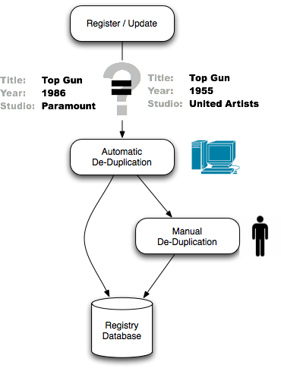
Uniqueness & de-duplication
Goal: Ensure that each work has exactly one ID
Match records: Confidence level generated based on available metadata
Low confidence matches require manual de-duplication
Registrants can request immediate pass/fail
EIDR matching tool available for pre-processing
Notes:
Multiple possible matches – operator decides whether match is exact to an existing item or the item is new
Registrants can request immediate pass/fail decision

Slide 68
Opaque unique identifier
Standard prefix
for EIDR registry
Unique suffix
for each asset
Check
digit
10.5240/ XXXX-XXXX-XXXX-XXXX-XXXX-C
Format
  Prefix identifies the EIDR registry in the DOI and handle systems
  Suffix is 20 hexadecimal digits and a Base 36 check digit
  Other formats
    Compact binary, URI, application-specific
Opaque numbers assigned by the registry
  Purely functional without any implication of ownership
  Remain the same regardless of asset or registrant ownership
  Central database contains all required data
68

