Slide 2
The Changing Scholarly Communications Infrastructure
Ed Pentz, Executive Director, CrossRef
Notes:
I’m going to be talking to you about the changing scholarly communications infrastructure from the point of view of CrossRef - I’ll talk about some of the big changes that have occurred over the last decade and how CrossRef grew out of these changes and help publishers do new things.

Slide 3
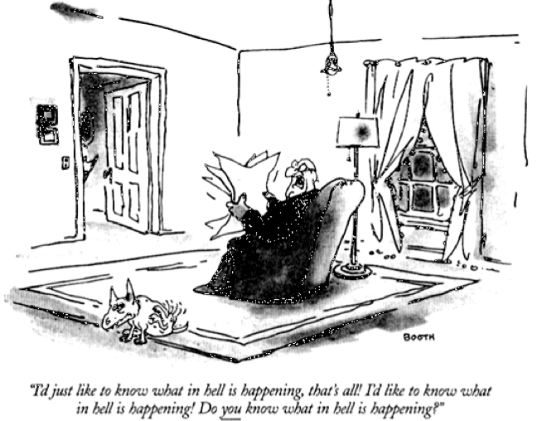
Notes:
I want to recognize that change can be difficult - sometimes it’s tough to keep up with what’s going on and the pace of change. To me this picture could be the typical publisher or librarian reacting to changes brought about by the internet and digital technologies.

Slide 4
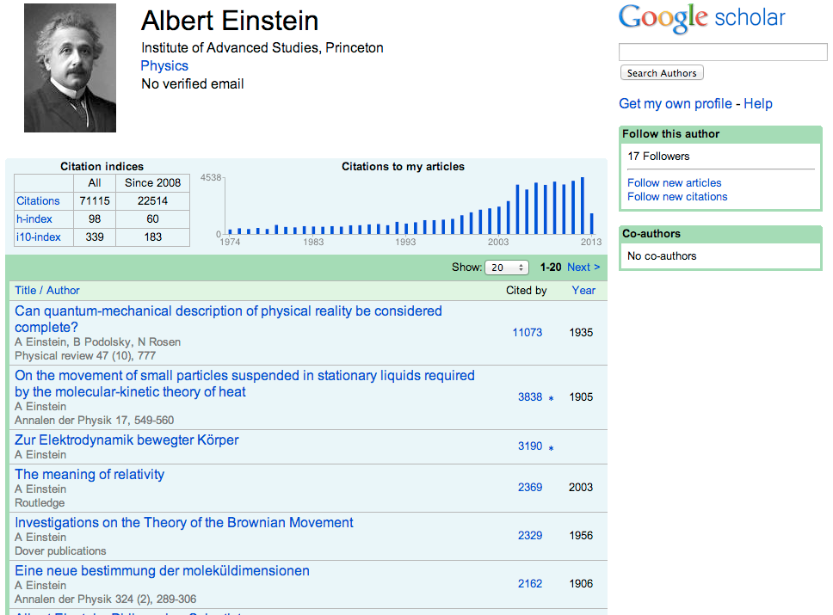


Notes:
First of all - something that represents one of the key changes in scholarly communications is something I’m sure everyone is familiar with - and that is Google. Google came into existence in 1998 and is now a powerhouse and it’s changed how people search, of course, but more fundamentally it changes how people discover information and what they know..
Numerous studies have shown that if something isn’t on the first page of results in Google it’s like it doesn’t exist. Changes expectations - scholarly services and content need to operate under Google rules Google isn’t just a consumer service - Google Scholar targets scholarly information and is doing citation indexing - h-indexes and other metrics and creating profile pages for researchers.

Slide 5
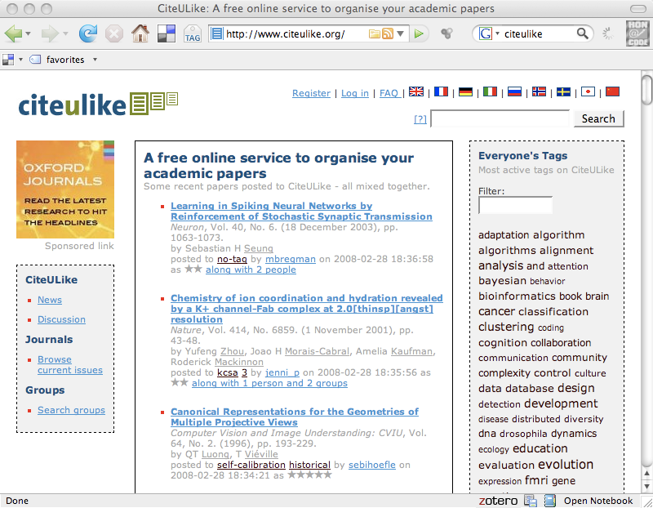
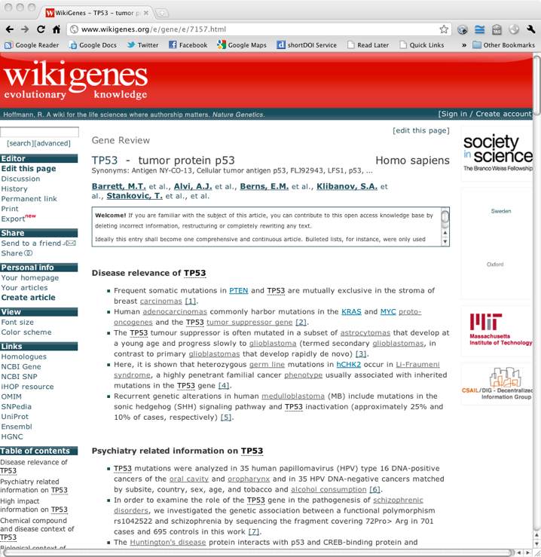
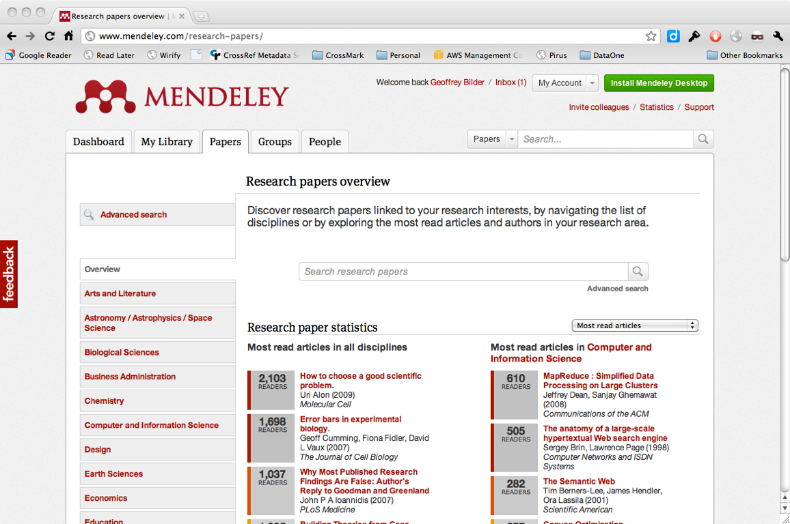
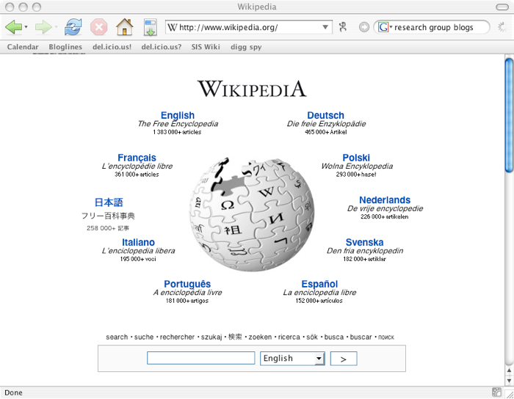
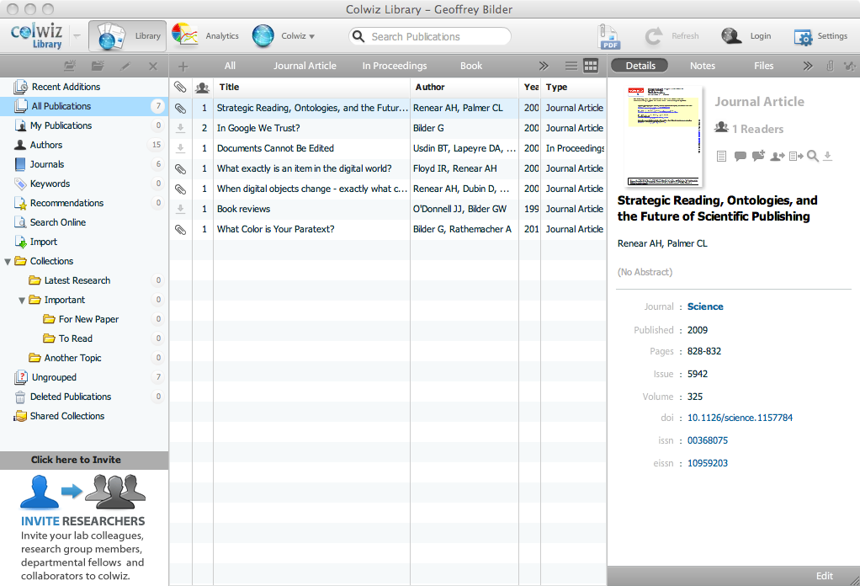
Notes:
Wikipedia - it has problems but it’s good enough and it’s getting used. Researchers are using it for collaborative, self-publishing projects. Publishers need to look at these things, experiment and see how they can get involved. There are many other new, online services being developed.

Slide 6
Current Reality
Everything is online – if it’s not online, it doesn’t exist
Everything is linked – if it’s not linked it doesn’t exist
The web breaks down barriers between academic and consumer behavior – expectations are set by Google, Amazon, Twitter, etc.
Notes:
Current reality for scholarly publishers of any kind....links - Google PageRank algorithm.

Slide 7
Current Reality
Article economy but journal brand stays strong
Economic models changed – consortial big deals, individual article sales , Open Access
Horseless carriage era is ending - PDF warehouses aren’t good enough
Publishers are moving from production houses to software/UX houses
Notes:
Now more specifically for journals - books have been less affected but this is now changing too.

Slide 8
Trust: The Publisher Problem
Value proposition being questioned
  Distribution
  Sales/Marketing
  Editorial/Production
Accused of profiteering
Content comparatively hidden
Brand increasingly hidden
Deprecation of intermediaries (”gatekeepers”)

Slide 9

“Trust Me”
Notes:
In human interaction in general - the worst way to get someone to trust you is to say “trust me” - without providing any other information to enable someone to assess WHY they should trust you.

Slide 10






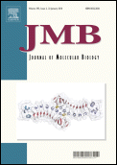
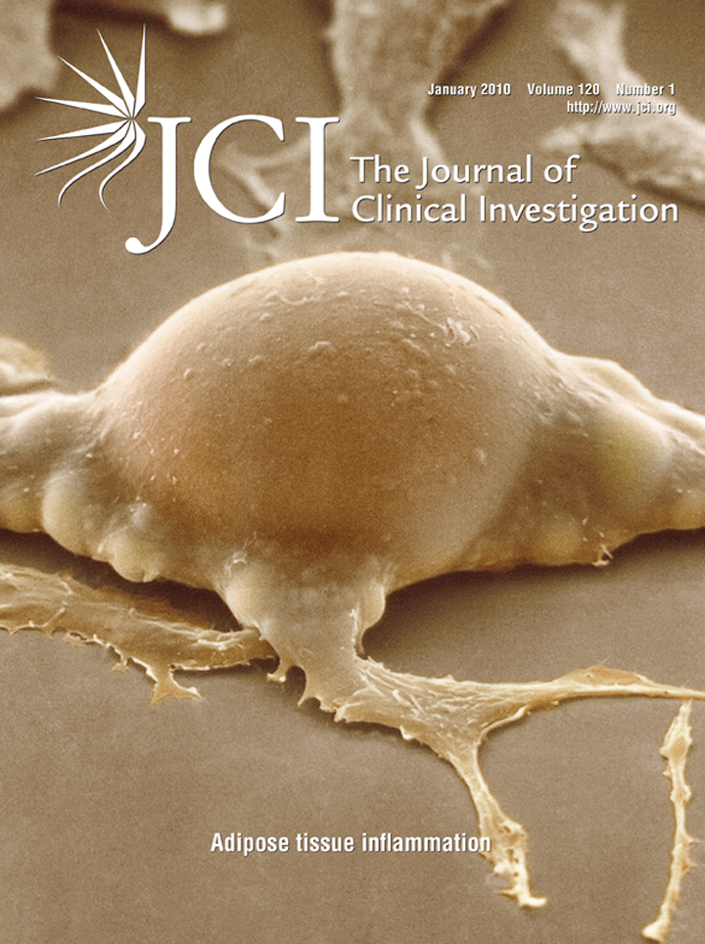

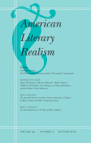

Registration, Certification, Awareness, Stewardship: editorial, production, marketing, access
Notes:
Trust is something that has to be built over time - and it has to be earned. As my colleague Geoffrey Bilder likes to say - the worst way to get somebody to trust you to is to just say “trust me”. publishers have built corporate brands which may have some importance to libraries but none for researchers. What researchers care about are the journal brands. Journals build their brands by performing essential services of Registration, Certification, promoting awareness and maintaining context.

Slide 11

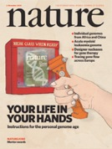
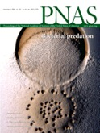


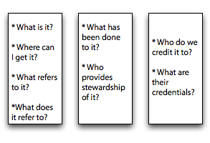
Brand
Is it relevant?
Is it good?
Is it important?
provenance infrastructure

Slide 12
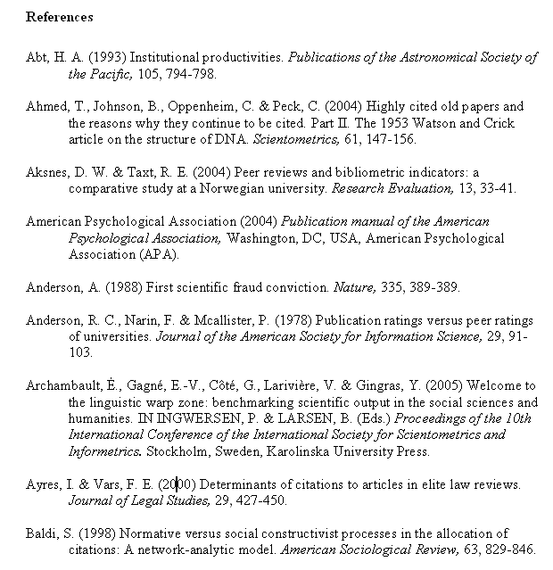
Notes:
To explain the background of CrossRef’s formation I want to take a look at a set of standard journal article references. References, or citations, are a crucial component of scholarly communications. They preserve the scholarly record which are the “minutes of science”. In the late 1990s publishers were putting content online and started signing bilateral linking agreements with each other and using URLs to link to one another. This was a difficult process - you had to figure out the publisher, keep track of URL schemes, keep it all up-to-date. The situation was not sustainable.

Slide 13

Notes:
Publishers quickly discovered that signing bilateral linking agreements with one another only benefited the lawyers and more importantly URL links are fragile and break.

Slide 14
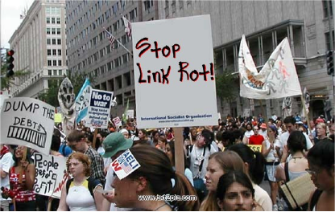

Notes:
For scholarly journal publishers have links break is not a good thing because it makes readers unhappy and they complain. The term Link Rot describes the phenomenon of more and more links in journal reference links breaking over time.

Slide 15
Computer scientist Diomidis Spinellis, for instance, examined 4,224 URLs in 2,471 computer science articles… and discovered that nearly half of the references could not be accessed within four years of the publication date. Links become inaccessible as time passes…”
Diomidis Spinellis. 2003. The decay and failures of web references. Commun. ACM 46, 1 (January 2003), 71-77. DOI=10.1145/602421.602422 http://dx.doi.org/10.1145/602421.602422
Notes:
Link Rot has been documented in the peer reviewed literature. Over time, fewer and fewer links in references work. In some cases within four years half of the links are broken.

Slide 16
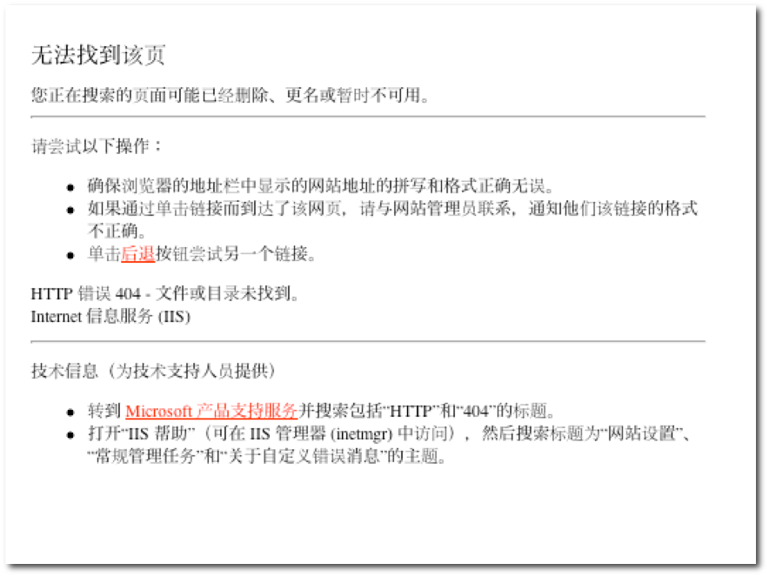


Slide 17
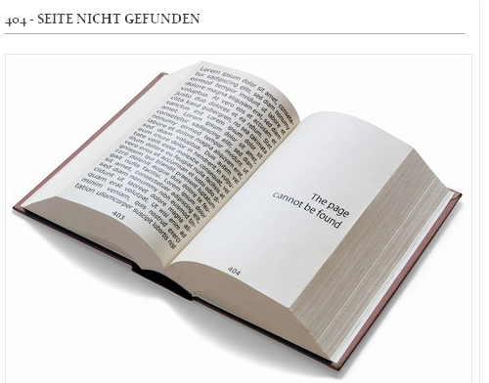
Photo: `R4cH3L on Flickr
Notes:
When a researcher is looking for high quality scholarly content you don’t want to retrieve the 404 - page not found error. Having this happen undermines trust in the scholarly system and in scholarly publishers.

Slide 18

Strategic .org
CrossRef: membership association of publishers
Founded for strategic reasons: services best achieved collaboratively
16 member board of directors from membership
Broad church: Commercial, societies, non-profits, university presses, OA publishers – 66% non-profit
All subjects: STM, humanities, social science, professional
A powerful NETWORK
Notes:
So at the end of 1999 a group of publishers got together and decided to collaborate to solve the problem and CrossRef was set up as a strategic org - CrossRef is a non-profit membership association of publishers with all members being equal. We were founded to provide services to publishers that are best achieved collaboratively - or doing those things that publishers can’t do on their own. We are run by and for publishers and we have a very broad church that includes all types of publishers. Network!

Slide 19
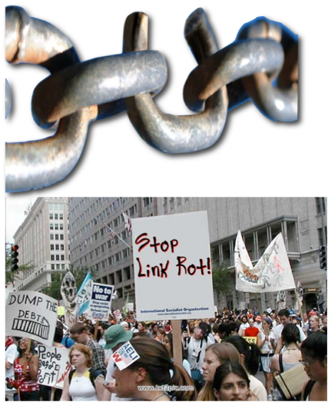
Technical Infrastructure
Unique identification
Persistent citation and linking - DOIs
Managed system – no broken links
Content discoverable
Notes:
CrossRef provides a technical infrastructure that includes unique identification using DOIs within a managed system to ensure there are no broken links. this makes the content discoverable.

Slide 20
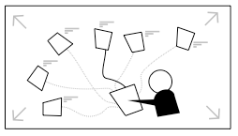
Provides an organizational foundation for widespread linking
One agreement with CrossRef is a linking agreement with all other CrossRef participants
Membership association for cooperative development of a digital linking infrastructure
Business model neutral

Slide 21


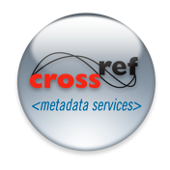

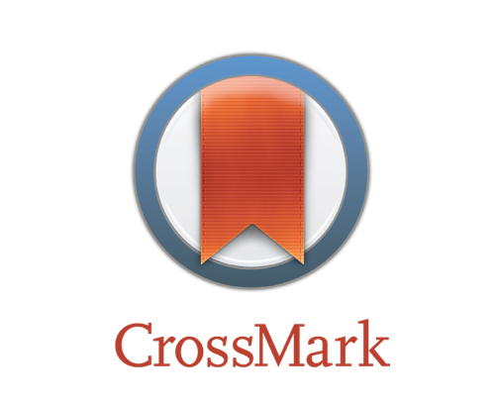


Services
Cross-publisher reference linking
Cross-publisher
Cited-by linking
Cross-publisher metadata feeds
Cross-publisher plagiarism screening
Cross-publisher
update identification
Cross-publisher
funder identification
Cross-publisher
text and data mining
Powered by iThenticate

Slide 22
Identifiers + Metadata
Services + Community
=
Powerful system for collaboration: persistent linking, discoverability, trust

Slide 23

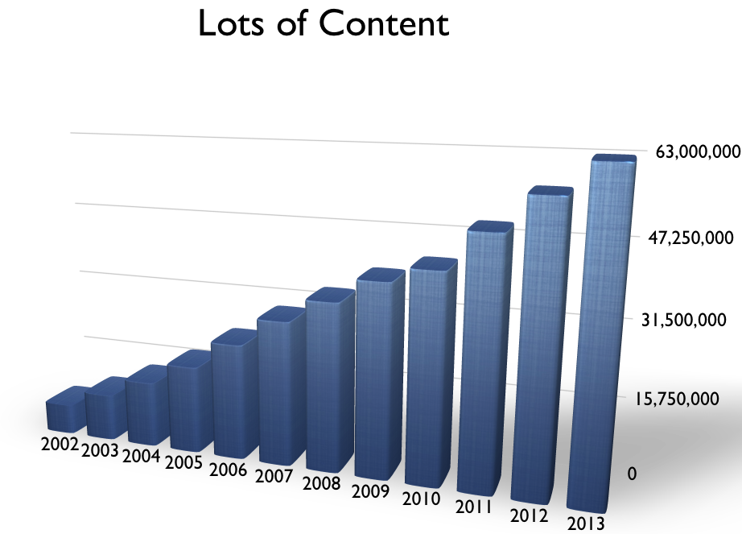
Notes:
We are also seeing continued growth in the amount of content and are approaching 63 million items

Slide 24
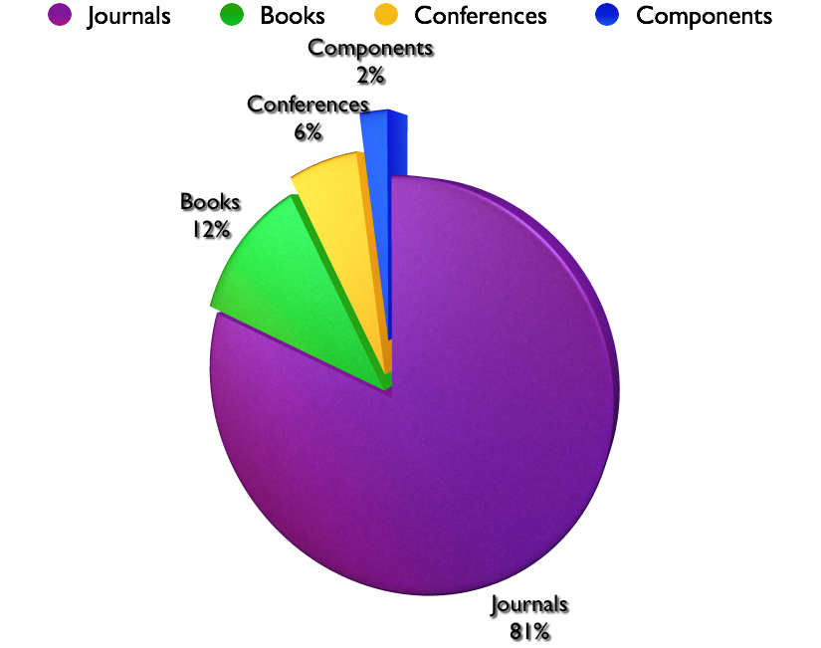
Notes:
this is largely journals but also include books, conference proceedings and components.

Slide 25
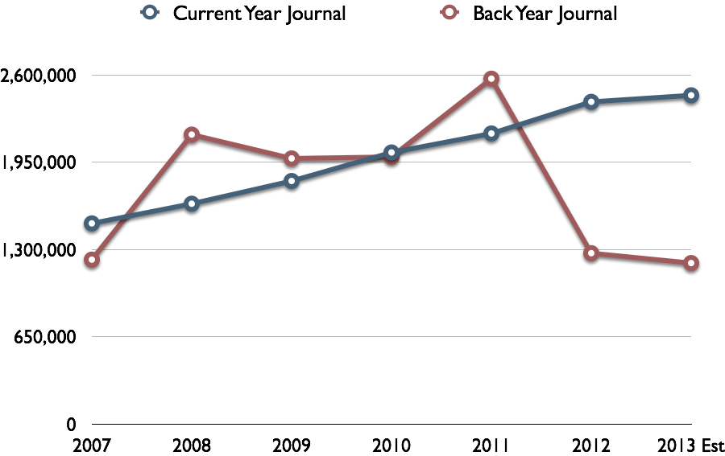

Slide 26
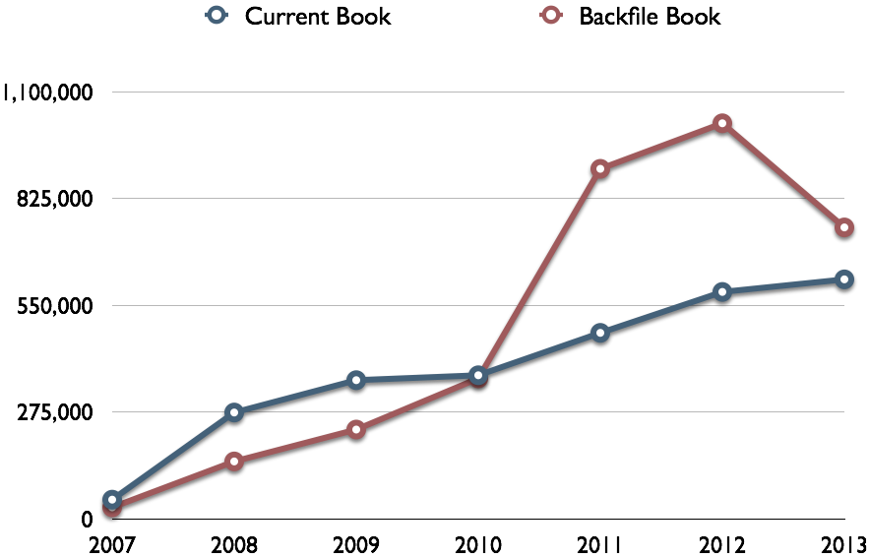

Slide 27
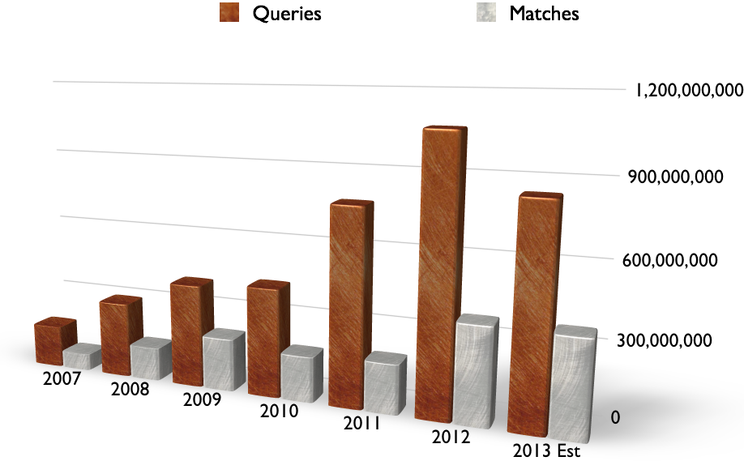

Slide 28
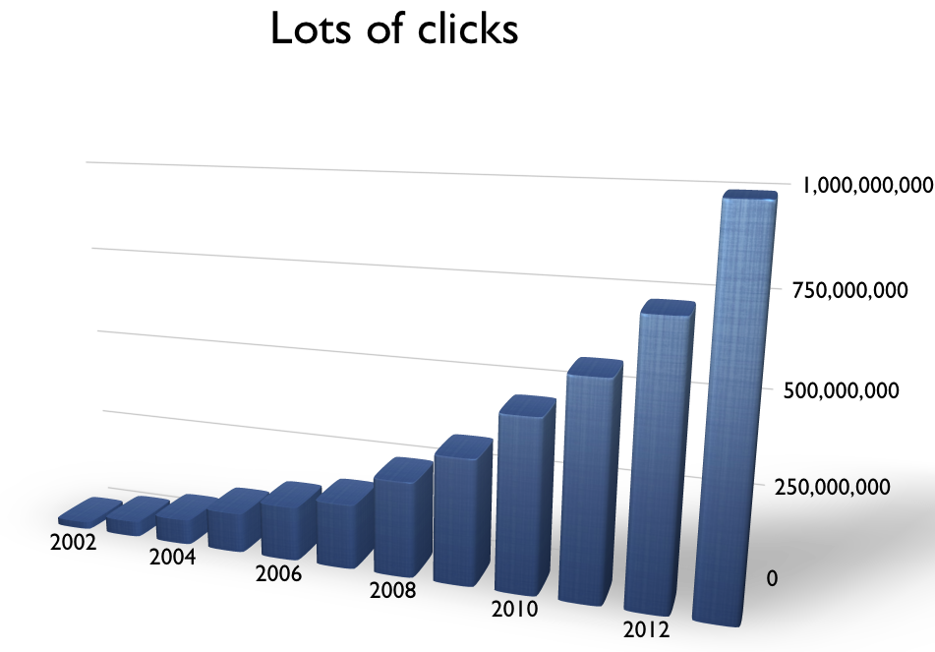
Notes:
We are also seeing continued growth in the amount of content and are approaching 45 million items

Slide 29

4,633 participating organizations
2,005 libraries

Slide 30
Lowest member tier - $275
82%

Slide 31

A standard way of reporting funding
sources for published scholarly research
🌍🌍
Notes:
And the latest project - one that we launched at the end of May this year - is FundRed. FundRef’s purpose is pretty simple - it has been developed to provide a standard way of reporting funding sources for published scholarly research. I’m going to start by covering why this is important.

Slide 32
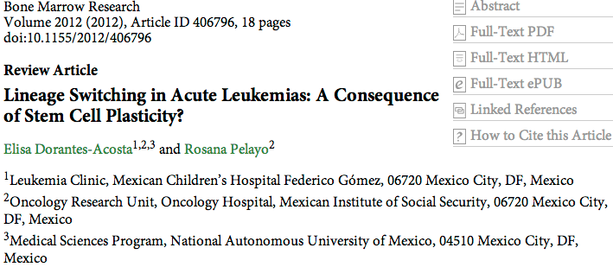
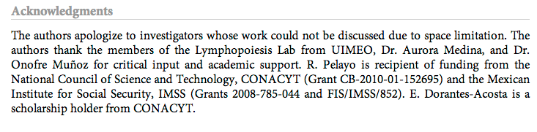
Notes:
Let’s take a look at some sample articles. Many journals and other publications include the authors’ acknowledgement of funding sources, but where and how this information is displayed varies widely. In this article it’s at the end just before the reference section under Acknowledgements, and it tells you the source of the funding and the grant numbers.

Slide 33


  National Institutes of Health
    NIH? N.I.H.? National Institute of Health?
  Abbreviations, misspellings, translations...
Notes:
When funding information is entered as free-form text by the author you are going to have inconsistencies - people will use abbreviations or alternative names or will misspell things. There’s no guarantee that you’ll be able to match up or de-duplicate the funding bodies and so a search for NIH might not return any publications that had reasearch supported by National Institutes of Health, and so on...

Slide 34

Why does this matter?
  Funding bodies cannot easily track the published output of funding
  Publishers cannot easily report which articles result from research supported by specific funders or grants
  Institutions cannot easily link funding received to published output
  Lack of standard metadata for funding sources makes it difficult to analyse or data mine
Notes:
So why is this important? Without any central database or standard way to store or search this data, all of the stakeholders struggle to get the information they need to fully analyse the outputs of funded research, and this impacts funding bodies, publishers and institutions. And any kind of large-scale analysis is extramely hard without a means to get hold of the data in a machine-readable format

Slide 35

Funders
Publishers
Established award systems and research management processes
Established publishing and peer-review systems
Relationship with researchers funded by agencies
Relationship with authors submitting manuscripts
Notes:
So FundRef is a collaborative solution to this problem, devised by - and for the benefit of - both publishers and funders. Both parties have an interest in the outcomes of FundRef, and both have well-established processes - one for recording the distribution of funds and monitoring the research process, and the other for ingesting, processing and publishing the outcomes of the research. The piece that has been missing is the one that links these two sets of processes, and that is where FundRef comes in, recording this link and making it more visible.

Slide 36

FundRef Pilot
Notes:
We’ve just completed a year-long FundRef pilot that ran until March of this year, and involved these organisations - the publishers on the left, and the funding bodies on the right. On successful completion of the pilot project the CrossRef board approved the FundRef service to go into production, which we did with our launch on May 28th.

Slide 37
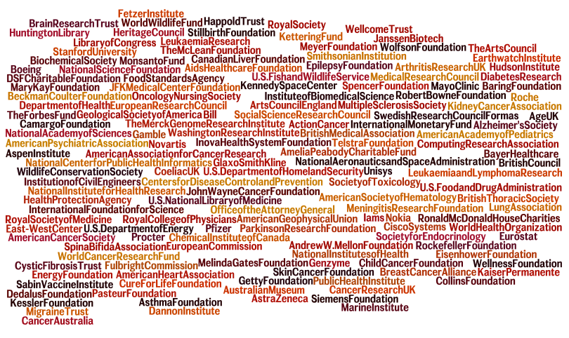
FundRef Registry
  4000 funder names and ID numbers from curated Elsevier SciVal registry, donated to FundRef
  Hosted by CrossRef, available under CC0
  Will be added to and updated
  Publishers to use this list to ensure consistency
www.crossref.org/fundref/fundref_registry.html
Notes:
One of the key things that came out of the pilot and is central to the project is an agreed taxonomy of funding bodies. The FundRef Registry has been created from a list donated to the project by Elsevier, and currently consists of around 4000 international funder names. The list data is and will be freely available under a CC0 license waiver. The Registry will be updated monthly, and new organisations sugested by publishers or funding bodies themselves will be added after curation. This is the list that publishers will use to collect information from authors on submission.

Slide 38



DOI
Funding
Source
Award
Number
Notes:
But the key piece is that the funding information is now centrally stored in the CrossRef database and can be queried. These three pieces of information - the DOI, the funding source or sources and award numbers are tied together in the metadata, making each of them discoverable via any of the other.

Slide 39


DOI
Funding
Source
Award
Number
Notes:
Taking this a step further, once this information is in the CrossRef database and ORCIDs are also being deposited, you have a scenario in which you can look up a researcher, find their publications, and see how their research was funded, or look up a grant number, see its associated DOIs and which researchers contributed to those publications. I’ll come back to querying the data later....

Slide 40
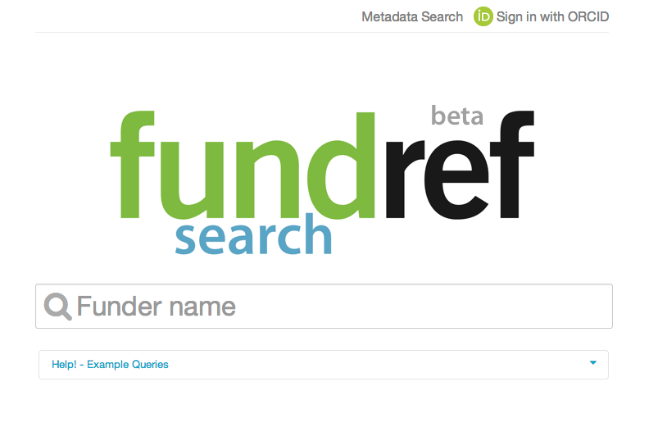
Look up funding data
http://search.crossref.org/fundref
Notes:
Then, when this data is in the CrossRef database publishers, funder and other interested parties can search on it, either through our FundRef Search interface or using one of our query APIs. FundRef Search is an interface specifically for looking up funding bodies and seeing papers that have resulted from their grants. If you want to look up award numbers or papers you will need to use CrossRef Metadata Search, which I will come to in a moment.

Slide 41

Notes:
FundRef Search directs the user to search using one of the funding body names in the registry. It handles acronyms so NIH will bring up the National Institutes of Health as in this example. You’ll see that countries are listed - which is important because more than one country has a “National Science Foundation”...

Slide 42
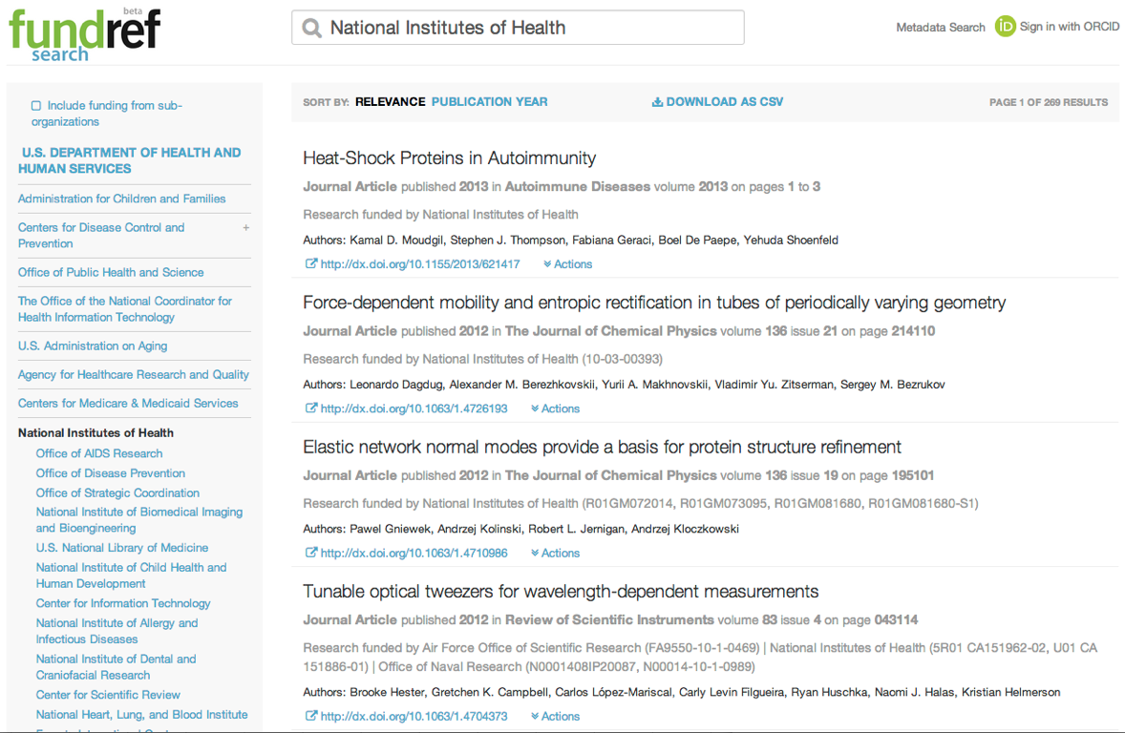
Notes:
Here I’ve used FundRef Search to look up the US NIH. You can see that it has returned a list of articles that have the NIH listed as a funder. In the first result we have the NIH listed as the funder but with no grant number. The second and third results show one grant number and then several. And the fourth article has NIH listed as one of three funding bodies, each with their own related award numbers.
Looking to the left of the screen you can see the heirarchy of funding bodies taken from the Registry. The NIH falls under the US Dept of Health and Human Services, a and below are all of the subsidiary funding bodies of the NIH itself. The default results are research funded by the organisation you searched on - but you have the option to include all subsidiary organisations too by checking the box at the top of the list. Then you will see results that list NIH and all of its subsidiary organisations.
We’ve just added this heirarchical browsing in so it’s a little bit of a work in progress and we’re missing the heirarchies for a few organisations, but it should give some really useful options for viewing a wider or narrower group of related funding bodies.

Slide 43
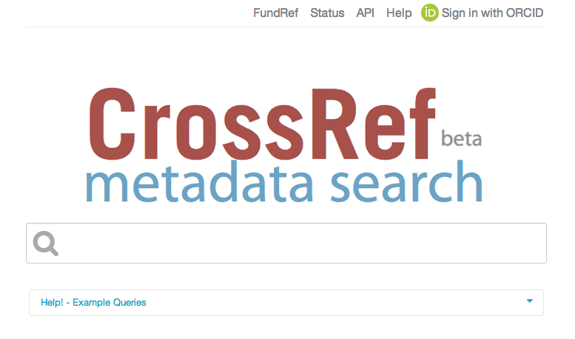
Notes:
As I said the FundRef Search interface lets you look up on funder names only - this is to allow us to pre-populate the standard names in the FundRef Registry as search terms. If you have other metadata and want to search on something else, you should use CrossRef Metadata Search, which as you might expect searches across all of the metadata in the CrossRef database.

Slide 44
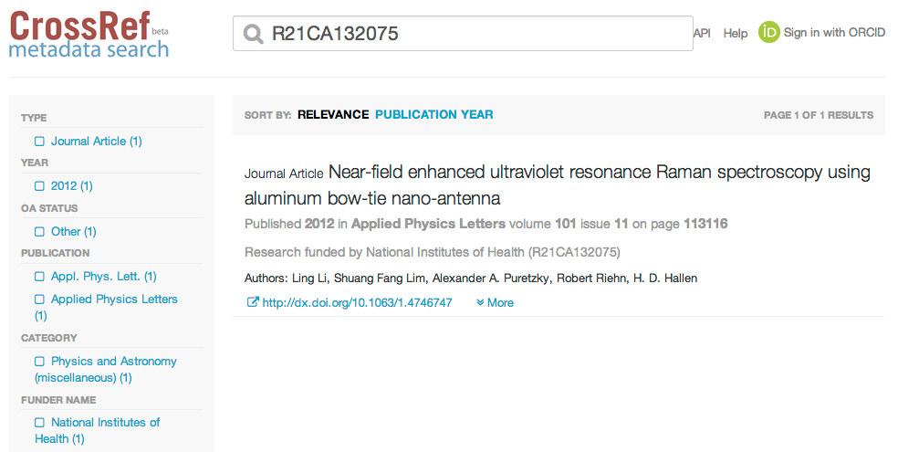
Notes:
Here I’ve entered a grant number and it has returned the associated journal article.

Slide 45
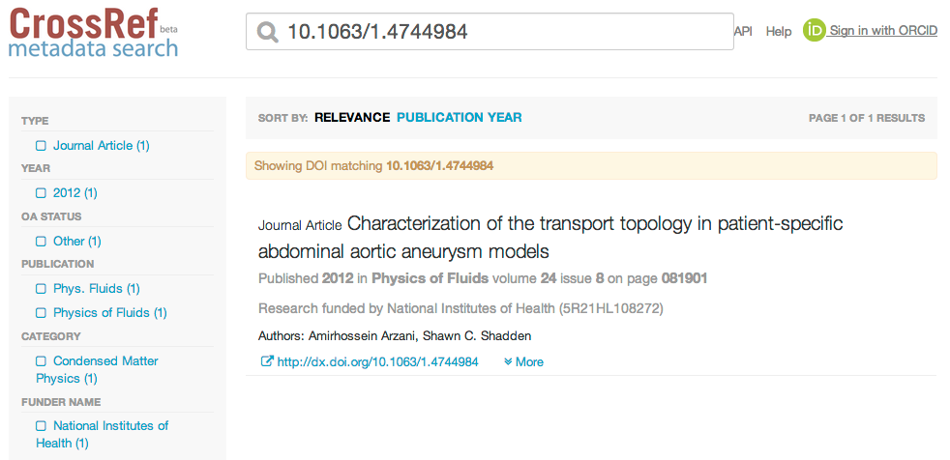
Notes:
Or you can enter a DOI and get the corresponding article metadata, including the funding information where it’s available.

Slide 46
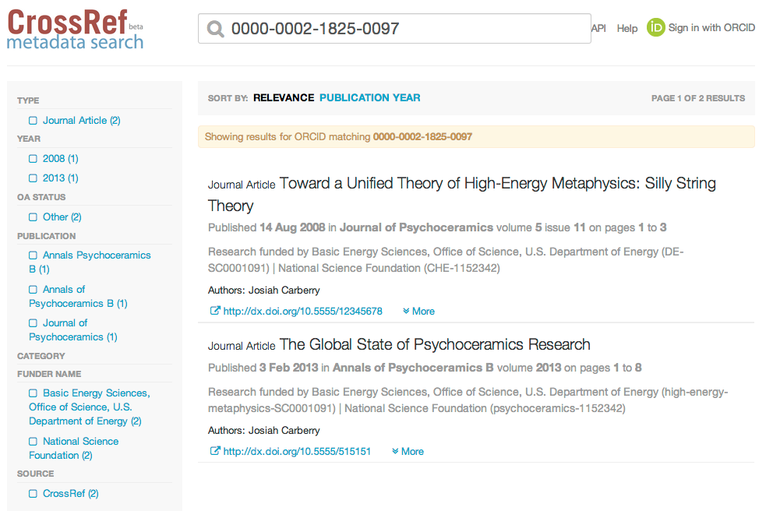
Notes:
Or you can enter an ORCID and return that authors papers with the funding information included. While I’m explaining all of this I must include the obvious caveat: FundRef has just launched so we have very little funding information in our database - just around 16,000 DOIs have funding data at present and mostly from physics journals. So a search for the Wellcome Trust won’t return any results for example. But if you search on a funding body and don’t see any results please don’t be alarmed - as more publishers deposit funding metadata you will start to see these results appear. The same is true of ORCIDs - a relatively small number of publisher depositing ORCIDs at this time, but again this will grow in the course of the year.
So we really need our member publishers to join and start depositing as soon as possible in order to make this a useful resource. I hope that these examples give you an idea of the huge potential for discovery that FundRef is going to offer.

Slide 47
American Chemical Society
American Diabetes Association
American Institute of Physics
American Psychiatric Publishing
American Psychological Association
American Physical Society
American Society of Neuroradiology
Association for Computing Machinery
Bioscientifica
Elsevier
FapUNIFESP (SciELO)
Hindawi Publishing Corporation
International Union of Crystallography
Internet Medical Publishing
IOP Publishing
Journal of Rehabilitation Research & Development
Just Medical Media, Ltd.
Kowsar Medical Institute
Landes Bioscience
Optical Society of America
Oxford University Press
Royal Society of Chemistry
The Royal Society
Wiley-Blackwell
http://www.crossref.org/fundref/fundref_agreement.html
Notes:
These are the CrossRef members who have signed up to FundRef so far (23) - those in bold have also started depositing metadata. Please do ensure that you sign the FundRef agreement before you start depositing so that we can list you as an official participant.

Slide 48

CrossMark
Content changes
When it does, readers need to know
Notes:
So in order to explain how CrossMark has come about, I’m going to start with a couple of fairly simple and statements.

Slide 49
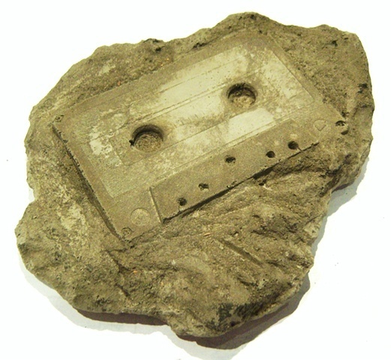
Content changes
Notes:
It’s easy to think that once something is published that’s it - the version of record is out there and that’s how it’ll stay. But we know it’s not as simple as that....

Slide 50
erratum
corrigendum
updates
enhancements
withdrawals
retractions
new editions
protocol updates
notices of concern, etc.
Notes:
Many things can happen to content after it has been published. It can be corrected, enhanced, retracted or even withdrawn, and of course it’s the publisher’s responsibility to apply these corrections and updates to the literature that they publish.

Slide 51


What is CrossMark?
A logo that identifies a publisher-maintained copy of a piece of content
Clicking the logo tells you
  Whether there have been any updates
  If this copy is being maintained by the publisher
  Where the publisher-maintained version is
  Other important publication record information
Notes:
So CrossMark. At its simplest it’s a logo that publishers will apply to content that they publish. When a reader clicks on the logo they will quickly and easily be able to tell:
The best way to explain it is to show some examples.

Slide 52
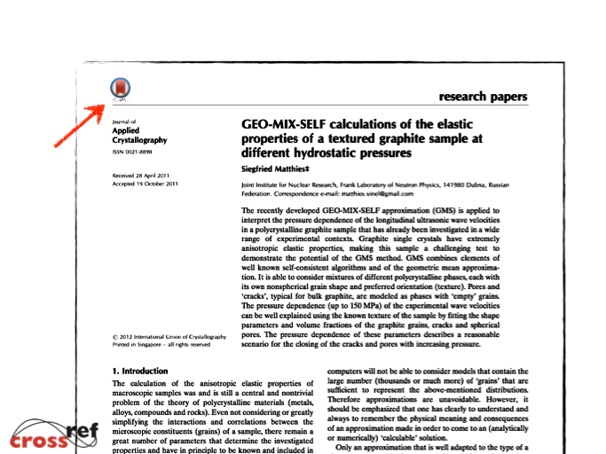
Notes:
I’ll start with the most useful common scenario. We’re looking at a PDF from the Journal of Applied Crystallography. This came from my hard drive. Or I downloaded it from the author’s web site. Or was it my university’s institutional repository? Maybe somebody emailed me a copy? No, wait, I think this was from my Mendeley account. And when was that?
At any rate, you see there is a CrossMark logo in the upper left corner. Providing I am online, when I click on the logo it will pop up a webpage...

Slide 53
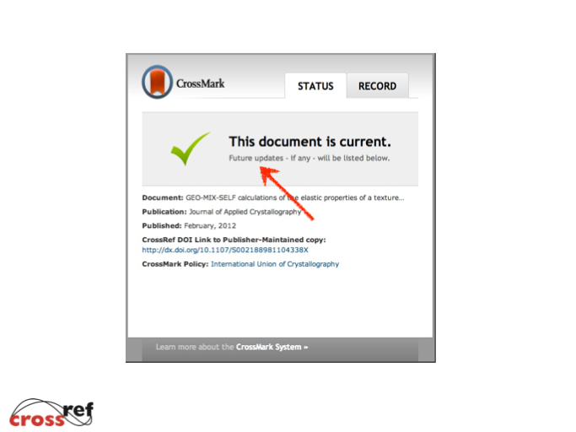
Notes:
with a pop-up dialogue box giving the latest status.
This is what most people will see - confirmation that the document is up to date, the CrossRef DOI link that will always point to the publisher-maintained copy, and a link to the publisher’s policies.
There are no updates. This time.... (click) And the box also tells the reader that Future updates - if any - will be listed below, so getting them used to the idea that if changes happen, this is where they can find them.
But what if there had been a correction?

Slide 54
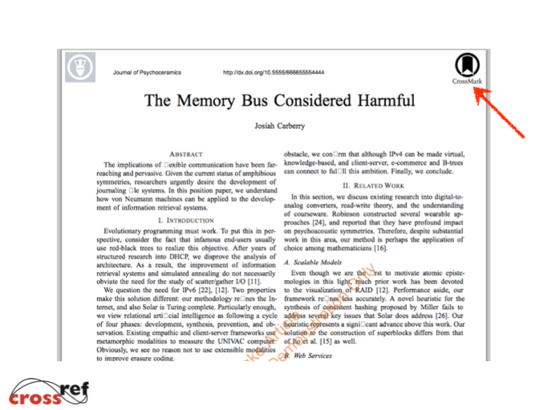
Notes:
Here’s another PDF. (For the record, this example is a mock-up from the fictitious Journal of Psychoceramics.) The CrossMark logo in a different place (click), though it works the same way.
I just click on the logo. ..

Slide 55
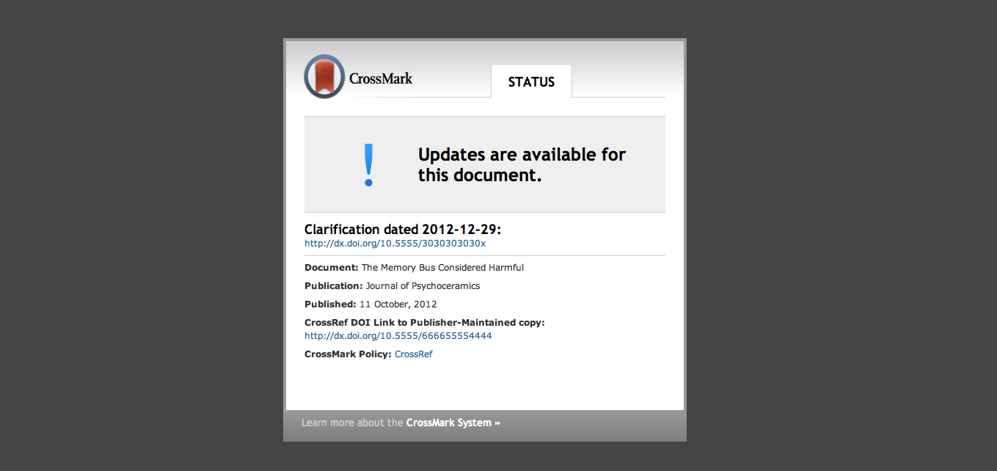
Notes:
Here, clicking on the logo brings up the same CrossMark dialog box... but I discover that there was a clarification issued for this document. It gives a link to the correction.
All I need to do is click on the CrossRef DOI link (click) to go to the update.

Slide 56
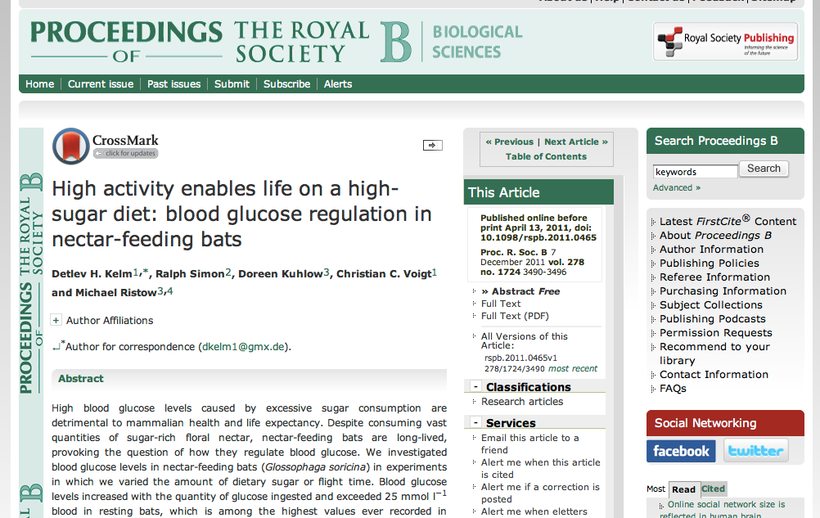

Notes:
Of course, these work the same way on publisher’s HTML pages. (Click) You see a real article from The Proceedings of The Royal Society B on Royal Society’s website. The CrossMark logo appears just above the article title here.

Slide 57
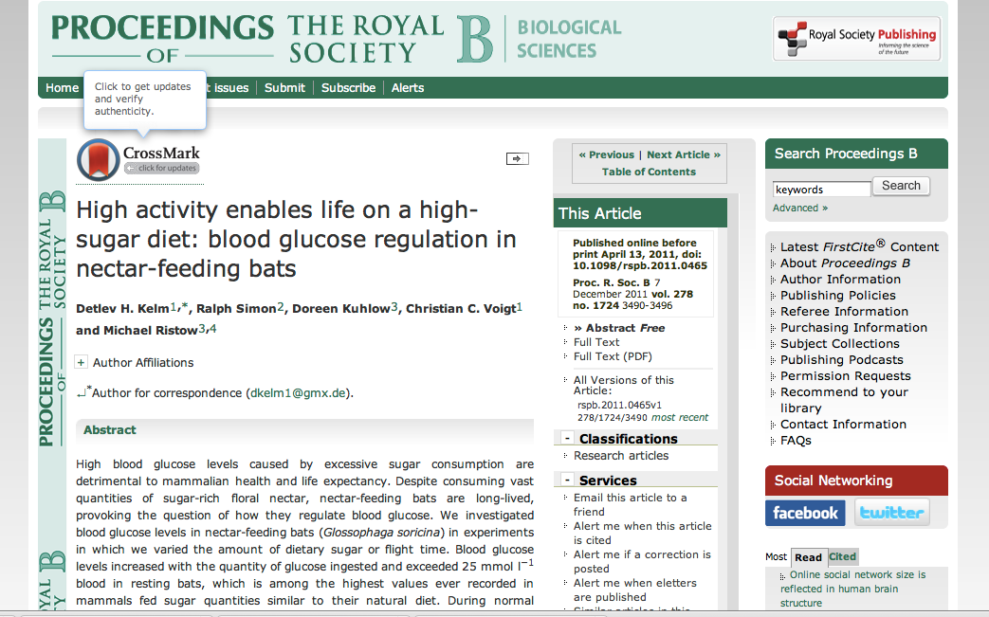
Notes:
Rolling your mouse over the logo brings up a text box that says Click to get updates and verify authenticity. And then when you click on the logo

Slide 58
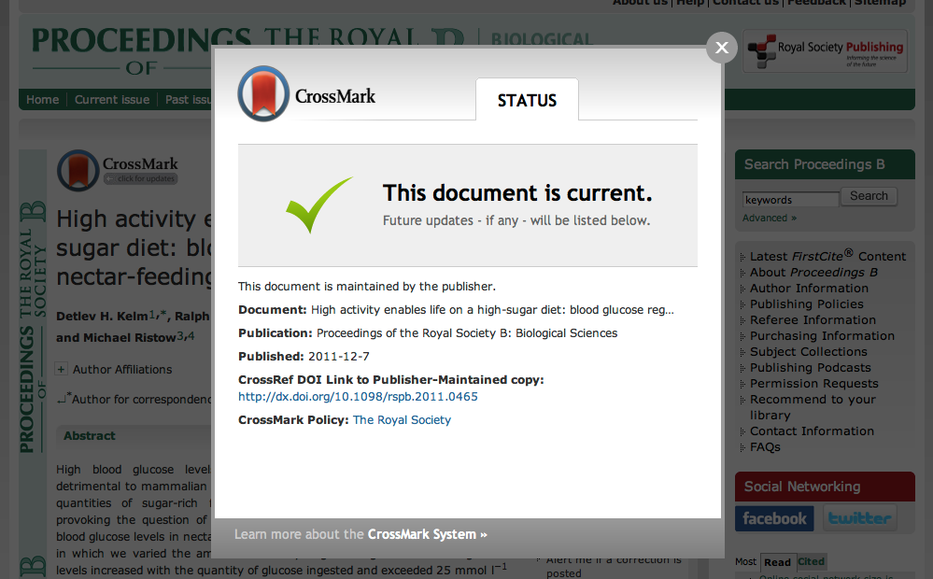
Notes:
You see the CrossMark dialog box. And this is what most people will see - confirmation that the document is up to date, the CrossRef DOI link that will always point to the publisher-maintained copy, and a link to the publisher’s policies. The box also tells the reader that Future updates - if any - will be listed below, so getting them used to the idea that if changes happen, this is where they can find them.

Slide 59


Notes:
The second example is of a corrected article from another of our pilot publishers, the International Union of Crystallographers. Here, clicking on the logo brings up the same CrossMark dialog box...

Slide 60
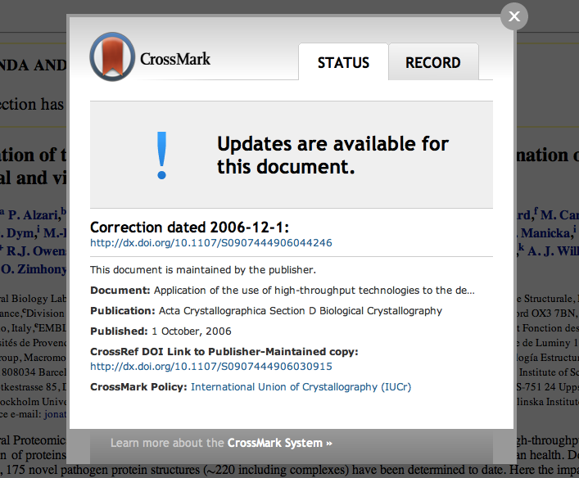
Notes:
..but with information that alerts the reader to changes. Updates are available for this document. It says that there is a correction and gives a link to the correction.

Slide 61

Notes:
You may have noticed in that previous example that there is an additional tab appearing in the dialogue box at the top here - the record tab.

Slide 62
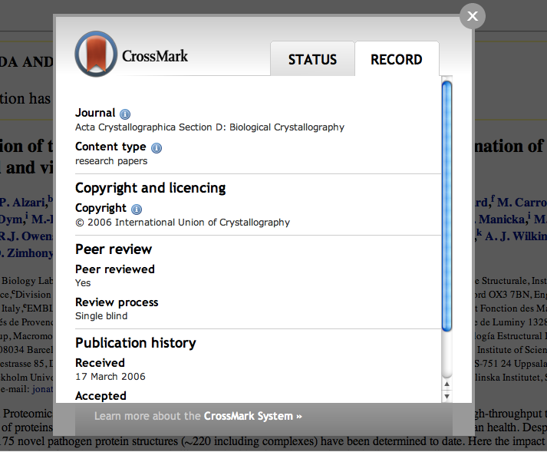
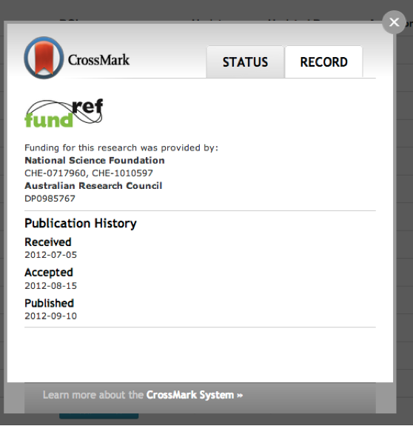
Text
Notes:
This is where you can show additional metadata about the piece of content if you choose to do so. The publisher decides what to put here and can use these fields to define publication practices. You don’t have to populate this tab at all if you prefer not to, and if you don’t supply an additional metadata the tab simply won’t show. The fields are defined and labelled by the publisher, and there can be as many or as few as you choose. This particular data from another of our pilot participants, the International Union of Crystallography, and you can see that they are sharing some really useful information on the copyright, review process and publication history. Also useful for FundRef!

Slide 63
What kind of Publication Record information could be available?
Funding disclosures
Conflict of interest statements
Publication history (submission, revision and accepted dates)
Location of data deposits or registries
Peer review process used
CrossCheck plagiarism screening
License types
and more...
Notes:
These are a few of the other possible pieces of information that have come up when talking with publishers. CrossRef isn’t going to advise on what publishers should display in the record box, but we expect that communities of interest may develop guidelines or best practices within different areas. There’s already a group of publishers discussing how best to display funding and grant information, for example.

Slide 64
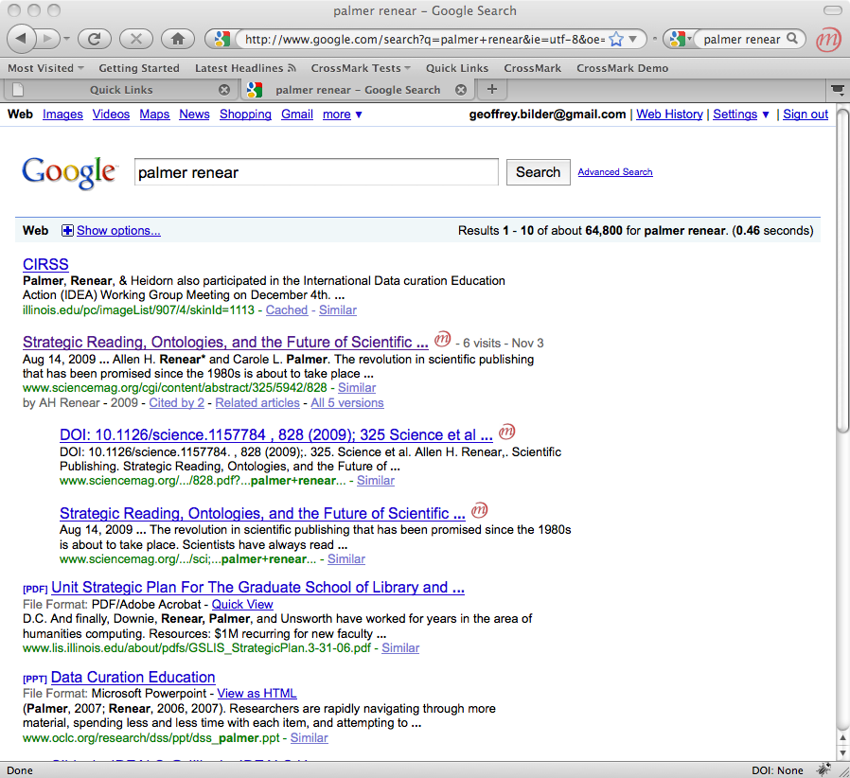
Notes:
CrossMark data will be freely available and machine readable and query-able, so could potentially be used in search results to flag content that has status verification and possible additional information, although this is something that we’ve just seen implemented in Microsoft Academic Search. We have had some conversations with librarians about using CrossMark data to populate link resolvers by pulling back relevant information, and also with other third parties such as bibliographic management systems who might be able to pull status updates into users reference lists and personal libraries.

Slide 65
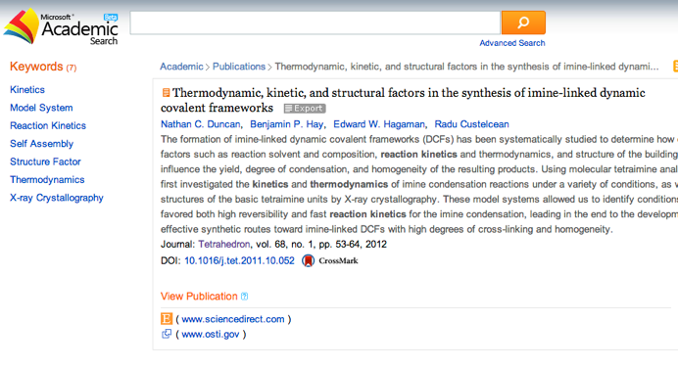
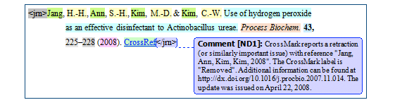
Notes:
Microsoft Academic Search implemented CrossMark on their platform in early February and are displaying the CrossMark logo on relevant content within their index. This is a useful development in terms of being able to publicise CrossMark to affiliates and show ways in which the CrossMark data can be used to identify the publisher version of a piece of content. Inera’s eXstyles have also just announced that they’re supporting CrossMark. If you’re using that tool for your references, eXtyles will now provide a warning if a reference has a CrossMark record that indicates it has been “retracted,” “withdrawn,” or “removed.”

Slide 66
Identifiers + Metadata
Services + Community
=
Powerful system for collaboration: persistent linking, discoverability, trust

